Slide 1


Cryptography & Network Security
Lecture Slide 2
CSE Department
University of Engineering & Management, Kolkata

Slide 2

Topics to be Covered
Model of Network Security
Basic Terminologies of Cryptography
Cryptanalysis
Steganography
Encryption & Decryption
Types of Cryptography

Slide 3
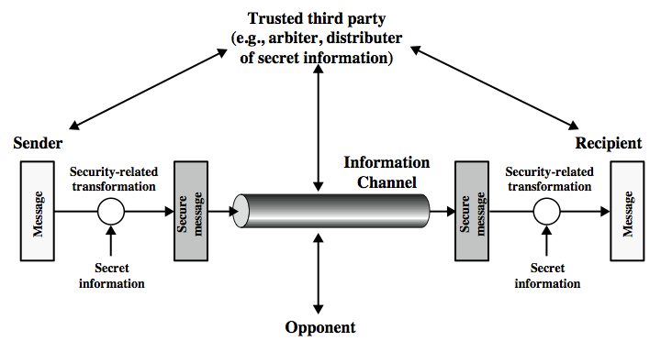
Model of Network Security

Slide 4
Model of Network Security
Using this model requires us to:
Design a suitable algorithm for the security transformation.
Generate the secret information (keys) used by the algorithm
Develop methods to distribute and share the secret information
Specify a protocol enabling the principals to use the transformation and secret information for a security service

Slide 5

Basic Terminologies of Cryptography
1. Plaintext :- The original intelligible message
2. Cipher text:- The transformed message or the message formed after cryptography application.
3. Cipher:- An algorithm for transforming an intelligible message into one that is unintelligible by transposition and/or substitution methods
4. Key:- Some critical information used by the cipher, known only to the sender & receiver .
5. Cryptographers:- People who do Cryptography

Slide 6
Basic Terminologies of Cryptography
6. Encipher (encode):- The process of converting plaintext to cipher text using a cipher and a key
7. Decipher (decode):- The process of converting cipher text back into plaintext using a cipher and a key
8. Cryptanalysis :- The study of principles and methods of transforming an unintelligible message back into an intelligible message without knowledge of the key. Also called code breaking
9. Cryptology:- Both cryptography and cryptanalysis
10. Code:- An algorithm for transforming an intelligible message into an unintelligible one using a code-book

Slide 7

Cryptanalysis
The process of attempting to discover X or K or both is known as cryptanalysis. The strategy used by the cryptanalysis depends on the nature of the encryption scheme and the information available to the cryptanalyst.
There are various types of cryptanalytic attacks based on the amount of information known to the cryptanalyst.

Slide 8
Cryptanalysis
Cipher text only – A copy of cipher text alone is known to the cryptanalyst.
Known plaintext – The cryptanalyst has a copy of the cipher text and the corresponding plaintext.
Chosen plaintext – The cryptanalysts gains temporary access to the encryption machine. They cannot open it to find the key, however; they can encrypt a large number of suitably chosen plaintexts and try to use the resulting cipher texts to deduce the key.
Chosen cipher text – The cryptanalyst obtains temporary access to the decryption machine, uses it to decrypt several string of symbols, and tries to use the results to deduce the key.

Slide 9

From this image I think you all will have an idea of what Steganography actually is????? A plaintext message may be hidden in any one of the two ways. The methods of steganography conceal the existence of the message, whereas the methods of cryptography render the message unintelligible to outsiders by various transformations of the text. A simple form of steganography, but one that is time consuming to construct is one in which an arrangement of words or letters within an apparently innocuous text spells out the real message.

Slide 10
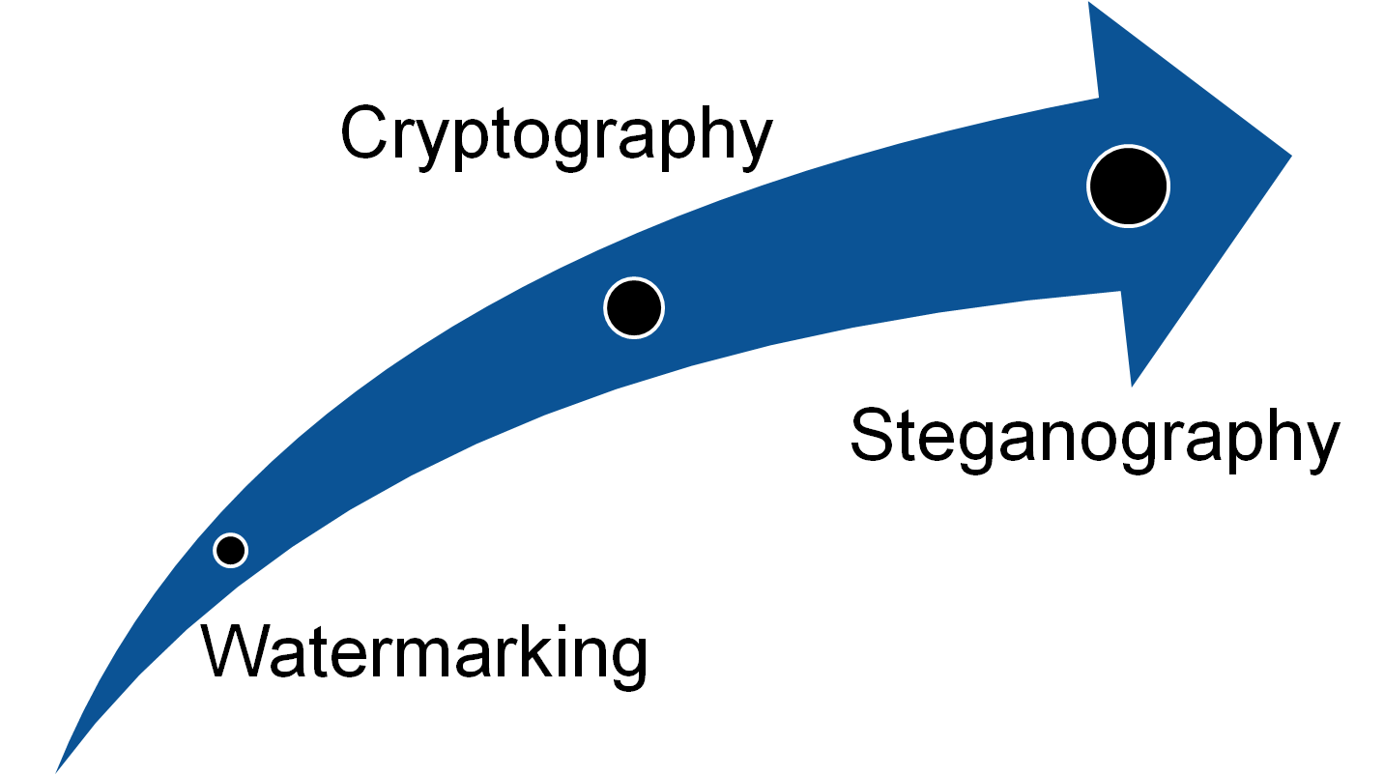
e.g., (i) the sequence of first letters of each word of the overall message spells out the real (Hidden) message.
Subset of the words of the overall message is used to convey the hidden message.
Drawbacks of steganography
Requires a lot of overhead to hide a relatively few bits of information.
Once the system is discovered, it becomes virtually worthless.

Slide 11
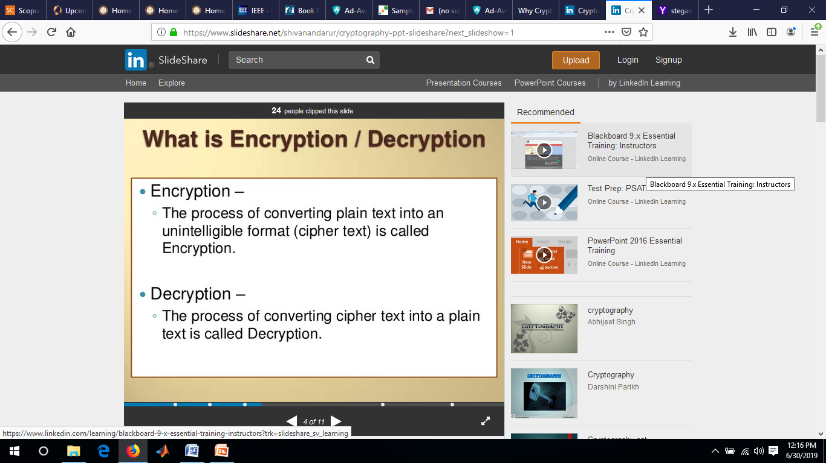

Slide 12
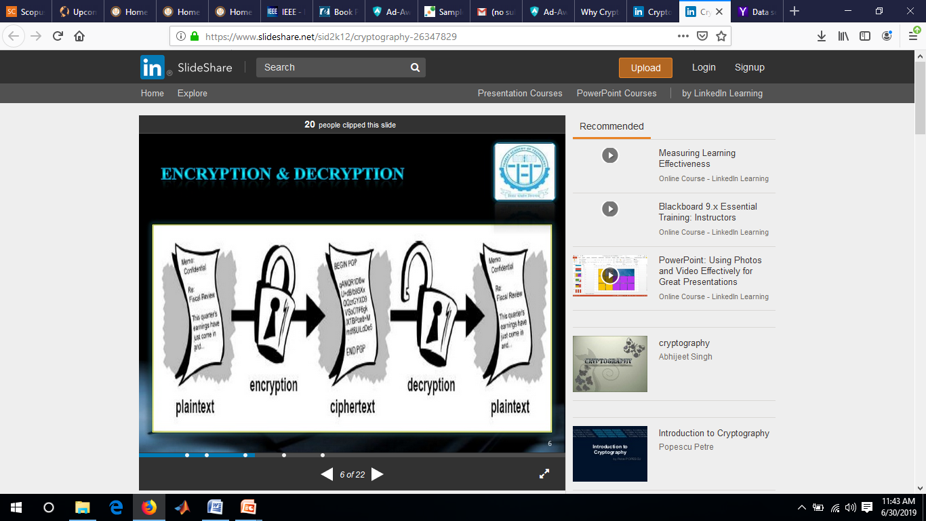

Slide 13
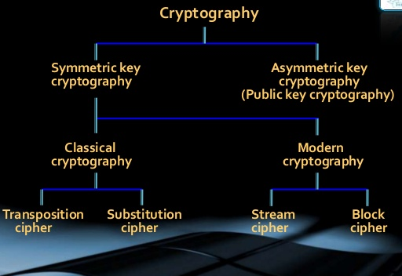
Types of Cryptography

Slide 14
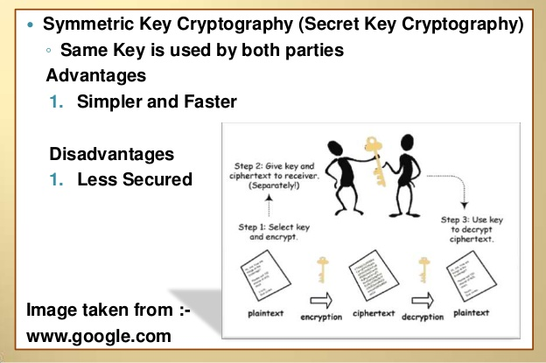

Slide 15
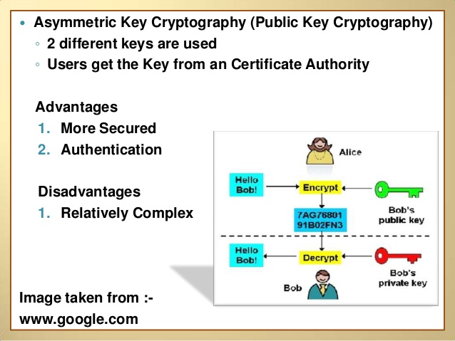

Slide 16


